Slide 1

Automatically Tightening Access Control Policies with Restricter
Ka Lok Wu¹
Christa Jenkins^{1,2}
Scott D. Stoller¹
Omar Chowdhury¹
¹ Stony Brook University
² Galois, Inc.
April 14, 2026

Slide 2
Roadmap
Access Control Policies
Policy Tightening Problem
Restricter: Insights and Design
Empirical Evaluation

Slide 3
Access Control
Goal: Regulating the permission of a subject's (principal's) actions on a certain object (resources)
An access control policy captures conditions under which an access is granted or denied
Typically, an access control policy contains a sequence of individual rules capturing different grant and/or deny conditions

Slide 4
Attribute-Based Access Control
Entities (principals and resources) have attributes of various types
Policy: conditions on the attributes
Example: permit if principal.role == ”Manager” and principal.department == resource.owner.department

Slide 5
Principle of Least Privilege
Broken access control is #1 in OWASP top 10: Critical security risk
Users should be given just enough permissions to perform their tasks
Overly Restrictive: hampers legitimate business use cases
Overly Permissive: Unauthorized users may gain access to critical resources

Slide 6
How Overly Permissive Policies Arise
Coming up with the right policy is challenging
The first draft of the policy may be inadequate or ineffective
Besides, permissions may evolve over time
New attributes can be added, or usage patterns can change
New over-privileges are introduced
Our Goal: After observing some real usage, update the policy to conform to the principle of least privilege
Notes:
Policy authors may not completely understand the exact privileges when they first come up with the policy.

Slide 7
Roadmap
Access Control Policies
Policy Tightening Problem
Restricter: Insights and Design
Empirical Evaluation

Slide 8

Problem Definition
Given
An initial access control policy
The policy environment (database of all entities)
An access log (request-decision pairs) consistent with the initial policy
we want to find a tightened policy such that
All decisions in the log are preserved
The tightened policy is as restrictive as the original

Slide 9
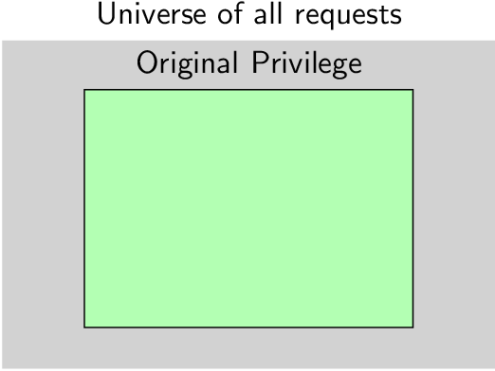
Ideal Tightening
Notes:
In the ideal situation, we would be able to identify the exact over-privileges and separate it from the required privileges. If we can do that, then we can trivially synthesize the best policy that only allow the required privileges.

Slide 10
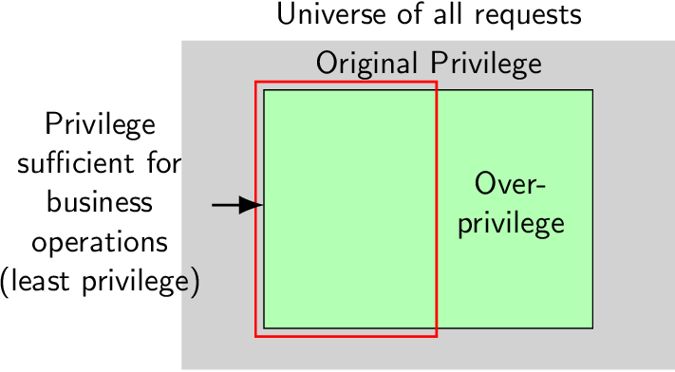
Ideal Tightening

Slide 11
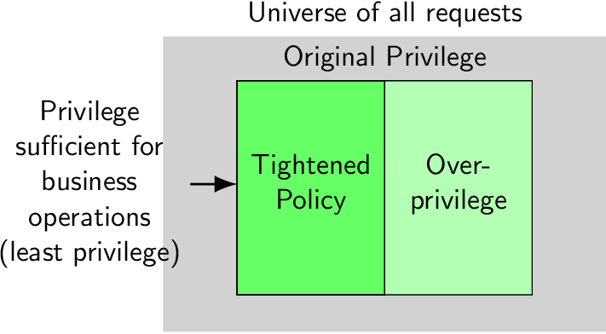
Ideal Tightening

Slide 12
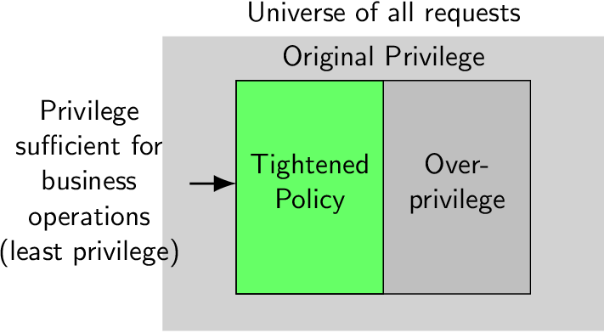
Ideal Tightening

Slide 13
Challenges
We do not know the exact over-privileges
Under-constrained in nature: there are many tightenings
Only allow the requests that appeared in the log: Overfit
Prefer simple policies: Maintainable and Generalizable
Insight: Heuristically approximate over-privilege by what did not appear in the log but are permitted (unused privileges)

Slide 14
Cedar
Developed by Amazon in 2023
Domain-specific authorization language
Expressive: Supports ABAC, RBAC, and ReBAC
Safe: Type-safe policies cannot have certain run-time errors
Tested against a formally verified implementation in lean

Slide 15
Cedar Schema
Typed entities (principals and resources)
Defines attributes, and the possible hierarchy relationships they can have
Action is only applicable to a subset of principal and resource types
Context: extra attributes in a request like IP address and time
entity User {isPcChair: Bool,...};
entity Area;
entity Paper {...};
entity Review {...};
action Read appliesTo {
principal: User,
resource: [Review, Paper]};

Slide 16
Cedar Policy
Consists of permit rules and deny rules
A rule consists of
Scope: types of principals, actions, and resources the rules apply to
Body: extra constraints
permit (principal,
action == Action::"Read", // Scope
resource is Paper)
when { principal.isPcChair }; // Body

Slide 17
Roadmap
Access Control Policies
Policy Tightening Problem
Restricter: Insights and Design
Empirical Evaluation

Slide 18
Design
Individually tightening rules
Local modification of each rule
With Syntax-Guided Synthesis (SyGuS)

Slide 19
Rule-wise Tightening
A request is permitted in Cedar if
At least one permit rule permits it
No deny rule denies it
Insight: Tightening individual permit rules also tightens the whole policy

Slide 20

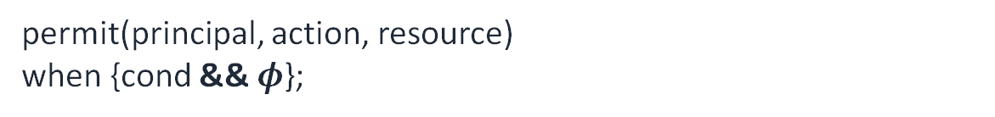
Local Strengthening of Rules
Permit rules look like
permit(principal, action, resource)
when {cond};
Notice that for any predicate $φ$,
permit(principal, action, resource)
when {cond && $φ$};
is syntactically more restrictive!

Slide 21
SyGuS
Synthesize a function that satisfies semantic restrictions and syntactic restrictions
Shallow embedding of Cedar policies as SMT terms
Difference of type system between Cedar’s symbolic encoding and ours
Challenge: Synthesize type-safe Cedar terms.
Notes:
Semantic constraints: quantifier-free formula

Slide 22
Type-Safety
Before accessing the attribute, make sure all the applicable entity types have the attribute
permit(principal, action, resource)
when{principal.isAdmin};
This is type-safe only when every applicable principal type has the required attribute isAdmin of type Bool.
However,
permit(principal, action, resource)
when{principal has isAdmin && principal.isAdmin};
is type-safe if every principal type that has the isAdmin attribute has it of type Bool.
Solution: Syntactically create type-safe Cedar terms by prepending typing restrictions.
Notes:
To understand why type-safety is a problem, we recall that each types of principals can have different attributes and a policy can apply to all types of attributes.

Slide 23
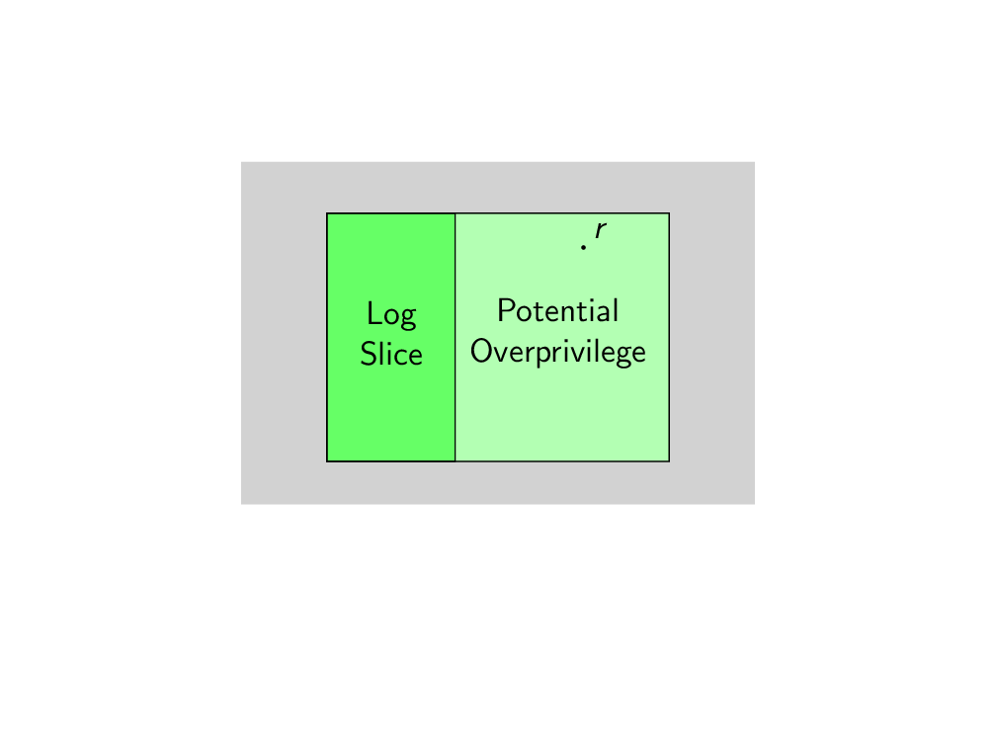
Step 1: Identify Potential Over-Privilege
We can either pick an unused privilege by
1. randomly sampling from the universe of all requests, or
2. Use an SMT solver.
Notes:
The algorithm of Restricter works as follows. We take each permit rule, and we identify some potential over-privileges with respect to that rule, which for us, again, is approximated by unused privileges.
Random sampling: which would not work very well if we have context of say, integer type

Slide 24
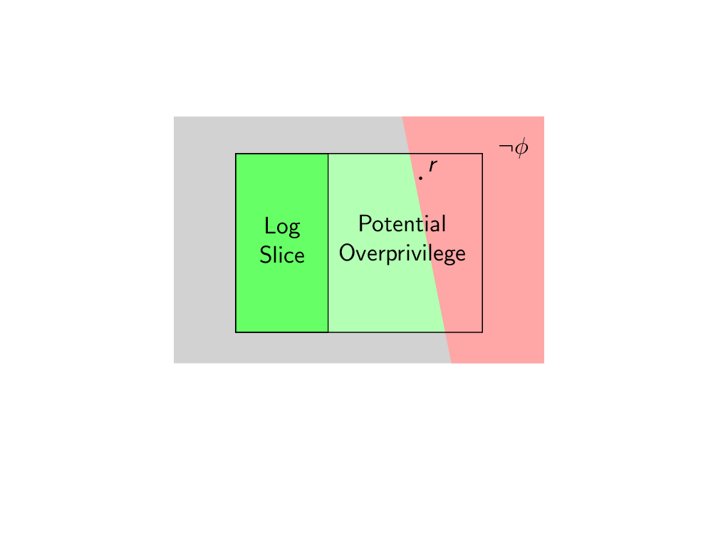
Step 2: Find Type-Safe Predicate that Denies Over-Privileges While Preserving Log Slice (SyGuS)
Notes:
Log slice: permitted request in the log that are permitted by the rule

Slide 25
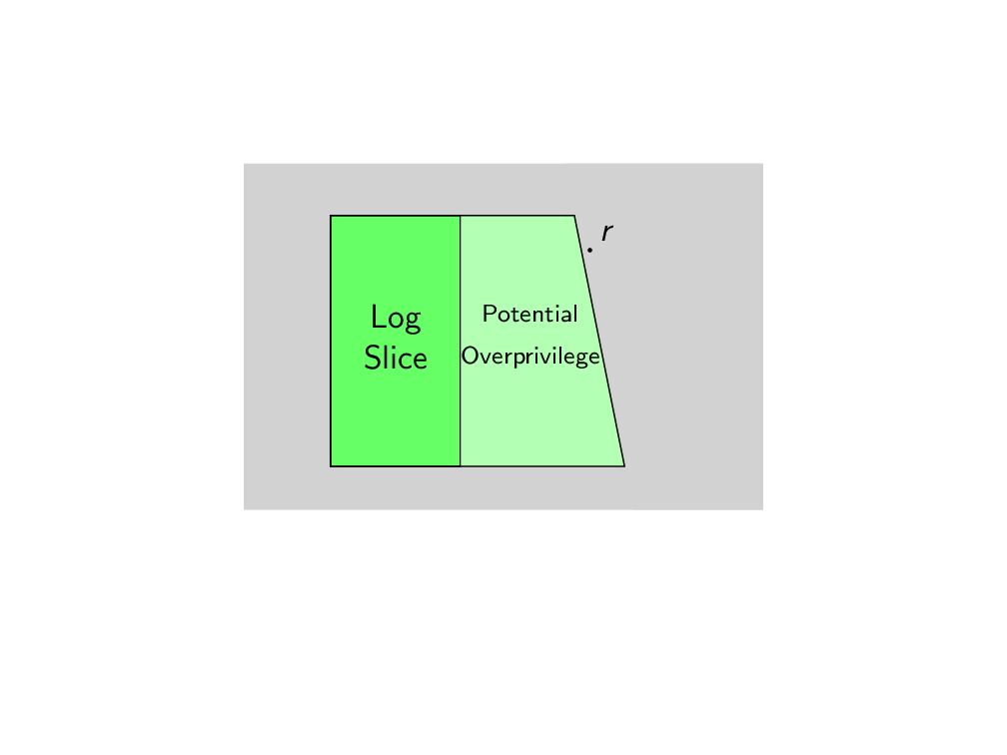
Result: Obtain a More Restrictive Rule
Insight 1: This rule is strictly more restrictive because at least r is denied in the new policy.
Insight 2: We avoid over-fitting to the log because we only add one conjunction of predicate at a time.
Notes:
And we can repeat this process by selecting another potential over-privilege to your hearts content

Slide 26
Roadmap
Access Control Policies
Policy Tightening Problem
Restricter: Insights and Design
Empirical Evaluation

Slide 27
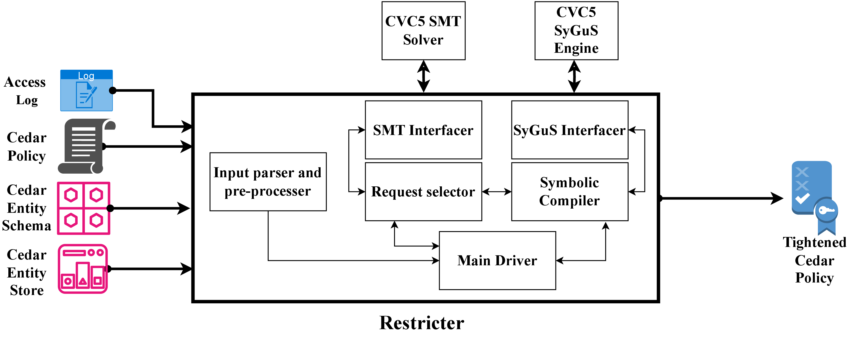
Implementation
Implemented in 2100 lines of Python and 400 lines of Rust
Used cvc5 as SMT solver and SyGuS engine
Supports a large fraction of Cedar

Slide 28
Research Questions
We want to know
If and when Restricter produces tight policies
How Restricter scales as problem size increases
We measure this by designing two artificial but plausible-seeming policies and logs.
Notes:
Unfortunately, as with other access control research, that we were not able to obtain real-world policies due to their sensitive nature.

Slide 29
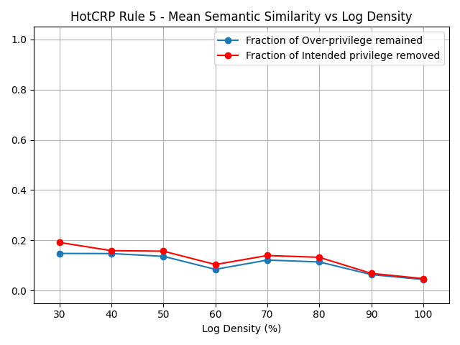
Semantic Quality
Semantic quality (lower is better) improves as the log became less sparse.
This shows that Restricter generates good tightenings even when the log density is low.
Notes:
In many cases, restricter was able to create an ideal tightening that removes all over-privileges while keeping intended privileges permitted. Even in more challenge cases, restricter could still recover good tightening, even when the given log is sparse.

Slide 30
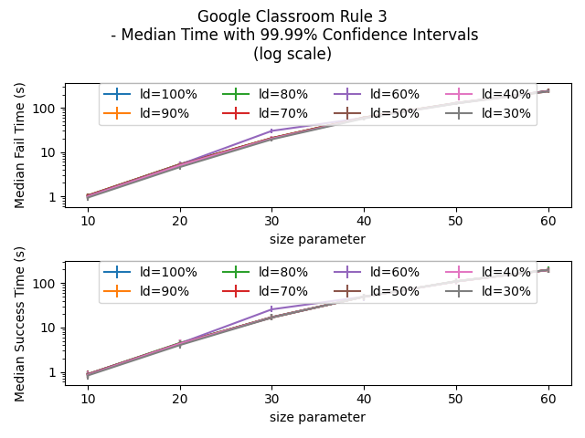
Scalability
SyGuS success and failure time (log scale) as the problem size increases.
This shows that Restricter scales well as the entity store and log size increase.

Slide 31
Limitations
Missing features
Constant synthesis: x + y < c where c is a symbolic constant
Rule overlapping: Access removed locally, not globally
(lack of) Diverse models from SMT solver
Notes:
We could not synthesize arbitrary type-safe cedar

Slide 32
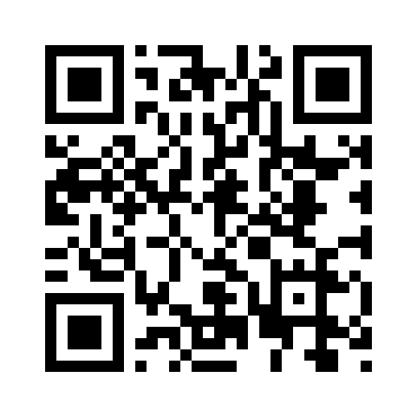
Thank you!
Questions?
Restricter tool

